Slide 1
Introduction to Data Science DSC500_T301_2231 Project “Bullying in the Workplace”
By: Stephanie Benavidez

Slide 2
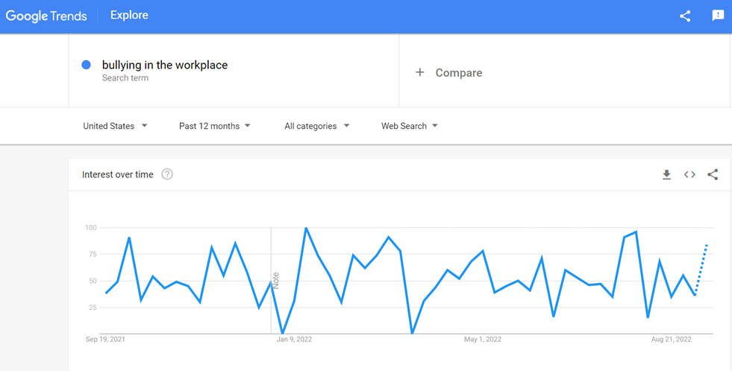
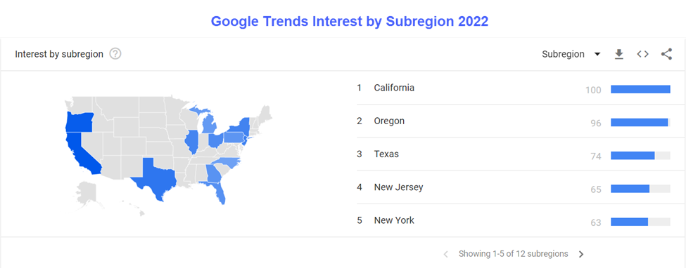
Google Trend
Allows you to see how the topic search has increased within past year.
Allows you to see that same topic search broken out by subregion.

Slide 3
What is workplace bullying?
According to (Workplace Bullying, n.d.), “workplace bullying can be defined as the repeated less favorable treatment of a person by another or others in the workplace, which may be considered unreasonable and inappropriate workplace practices.”

Slide 4
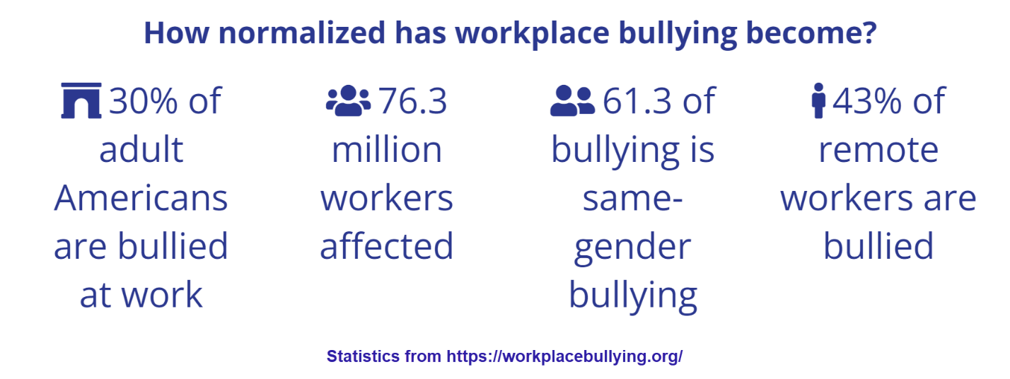
How common is it in the workforce today?
According to the statistics from (Workplace Bullying, n.d.), results show that about 30% of adults are bullied at work.

Slide 5
What are the forms or types of workplace bullying?
Threatening
Intimidating
Humiliating
Work Sabotage
Singling Someone Out
Giving impossible deadlines
Retaliation
Using insulting or offensive language

Slide 6
How can it be handled?
Document everything – keep emails, write down everything that happens, and take audio records (depending on state laws and consent)
1
Keep dates, and times, including everyone that was around, and the place where the situation happened
2
Bring the situation to your supervisor or next in command, or HR.
3

Slide 7
Can it cause any mental or physical problems? Yes, bullying can have a significant effect on both physical and mental health (Raypole, 2019).
Mental Effects
Anxiety
Depression
Low self-esteem
Dreading work
Self-doubt
Losing interest
(Raypole, 2019)
Physical Effects
High blood pressure
Insomnia
Digestive issues
Mood changes
Panic attacks
Stress
(Gordon, 2022)

Slide 8
Conclusion
Bullying in the workplace is becoming more noticeable and acknowledged
Employees are wanting to be heard, rather than be silent
Human Resources department should provide an Employee Handbook with Policies and Procedures

Slide 9
References
Bullying in the Workplace. (2022, September 18). Retrieved from trends.google.com: https://trends.google.com/trends/explore?geo=US&q=bullying%20in%20the%20workplace
Gordon, S. (2022, February 21). The Effects Of Workplace Bullying. Retrieved from https://www.verywellmind.com: https://www.verywellmind.com/what-are-the-effects-of-workplace-bullying-460628
Raypole, C. (2019, April 29). How to Identify and Manage Workplace Bullying. Retrieved from https://www.healthline.com: https://www.healthline.com/health/workplace-bullying#signs
What is workplace bullying? (n.d.). Retrieved from https://workplacebullying.org/: https://workplacebullying.org/
Workplace Bullying. (n.d.). Retrieved from adminfinance.umw.edu: https://adminfinance.umw.edu/hr/employee-relations/respectful-workplace-policies/workplace-bullying/
Workplace Bullying: Know Your Rights. (n.d.). Retrieved from tcdd.texas.gov: https://tcdd.texas.gov/workplace-bullying/

